Slide 1
A moving dot hologram in a 3-by-3 square lattice
Notes:
integration

Slide 2
A moving dot hologram
Sample plane phase
Recovered image
Imaginary gauge field implementation

Slide 3


A moving dot hologram by Gaussian dots
Near Field
$$200μm$$
$$z=1000μm$$

Slide 4
Microring lasers

Slide 5
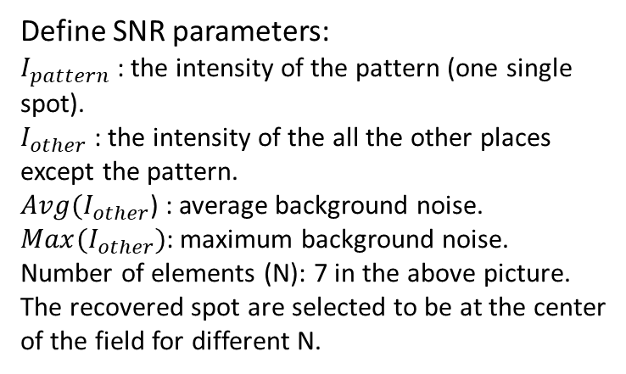


Improving Hologram Quality
Spacing = 50µm;
z = 200µm;
SNR1
SNR2
Define SNR parameters:
$I_{pattern}$ : the intensity of the pattern (one single spot).
$I_{other}$ : the intensity of the all the other places except the pattern.
$Avg(I_{other}$) : average background noise.
$Max(I_{other})$: maximum background noise.
Number of elements (N): 7 in the above picture.
The recovered spot are selected to be at the center of the field for different N.
Number of elements
Number of elements
$${SNR}_{1}=\frac{I_{pattern}}{Avg(I_{other})}$$
$${SNR}_{2}=\frac{I_{pattern}}{Max(I_{other})}$$
As the number of elements increase, the SNR of recovered image also enhances.
Code at: Green_Function_Inverse_Design2.m

Slide 6
Why the number of elements matters
N=7
N=21
With more number of elements, the sample plane has more pixels to depict the near field pattern (which looks more continuous)

Slide 7


Influence of Geometry
N=7
geo(50, 300)
geo(50, 200)
geo(spacing, z) | SNR1 | SNR2
(100, 500) | 8.187496 | 30.6341
(100, 400) | 11.5452 | 42.16804
(100, 300) | 9.648251 | 32.38401
(100, 200) | 18.5265 | 84.48403
(100, 150) | 9.413903 | 63.63082
(100, 100) | 3.627695 | 15.50923
(50, 100) | 25.74501 | 65.84172
(50, 200) | 18.73974 | 52.93234
(50, 300) | 5.439647 | 12.95019
(50, 400) | 6.531971 | 19.38925
(50, 500) | 6.973702 | 27.17361
Highest SNR
Lowest SNR
<from the left table>
$${SNR}_{1}=\frac{I_{pattern}}{Avg(I_{other})}$$
For a fixed N, the SNR can also be optimized by the geometry: spacing of elements (spacing), and observation plane height (z).
$${SNR}_{2}=\frac{I_{pattern}}{Max(I_{other})}$$

Slide 8
Ring Resonator Implementation
Near field
geo(50, 200)
geo(50, 300)
Higher SNR
Lower SNR
Higher SNR makes the recovered image more clear.

Slide 9
3by3 case
geo(dW, z) | SNR1 | SNR2
(100, 500) | 5.230854 | 9.501583
(100, 400) | 8.813588 | 12.28174
(100, 300) | 10.72091 | 19.95063
(100, 200) | 3.825239 | 6.940816
(100, 150) | 2.842322 | 4.333135
(100, 100) | 2.589689 | 3.343164
(50, 100) | 20.59093 | 20.59093
(50, 200) | 10.50655 | 20.9842
(50, 300) | 1.739372 | 1.879376
(50, 400) | 2.168125 | 3.138544
(50, 500) | 7.913782 | 8.557932
Higher SNR
(50, 200)
Lower SNR
(50, 300)
N = 3

